Slide 1

Project Title : IT , Mechanical , Civil & Electrical Courses Details with Registration Form
Submitted to sr . Pruthviraj Singh
(Software engg )

Slide 2
Project title : Course Details
Platform for IT , Mechanical , Civil & Electrical Courses

Slide 3
Project title : Course Details
PROJECT EXPLAINATION:
# In this project firstly I create a web page & on that web page I create pdf registration form
and enter the course details of the CadDesk Institute.
# The website is consist of HTML , CSS , JAVASCRIPT & BOOTSTRAP code.
# The HTML part of code is used to enter the data by using html tags.
# The CSS & BOOTSTRAP part of the code decides how the website page looks &
JAVASCRIPT code is used to create pdf of registration form.

Slide 4
Project title : Course Details
TECHNOLOGIES I LEARNT:
# Technologies I have learnt in this course are:
1)HTML
2)CSS
3)JAVASCRIPT
4)BOOTSTRAP

Slide 5
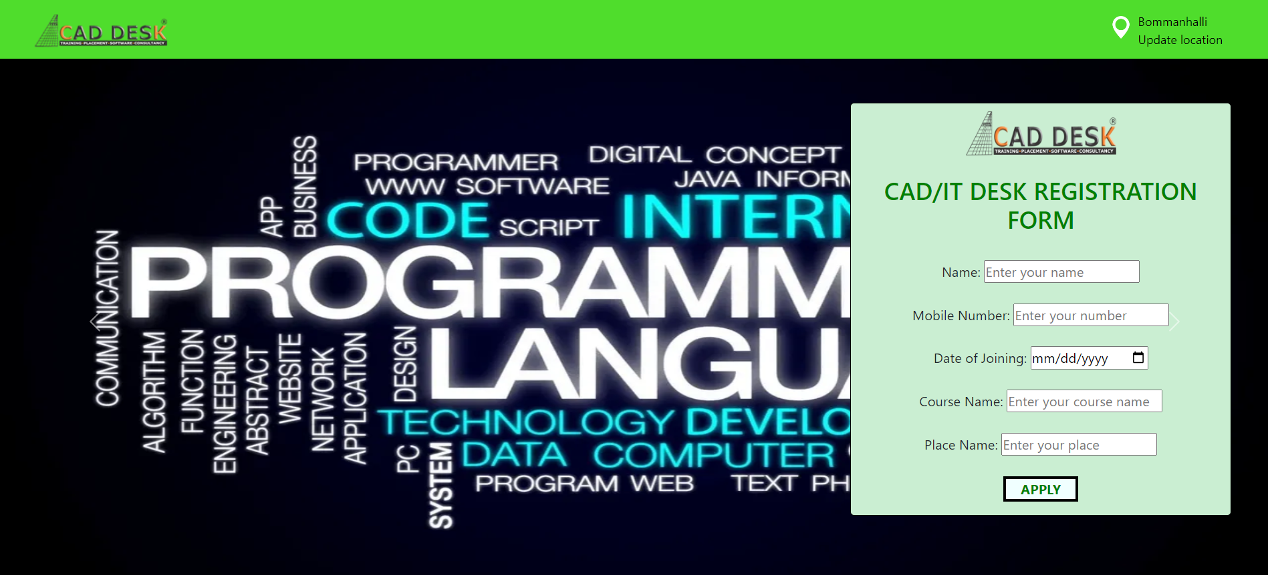
Project title : Course Details

Slide 6
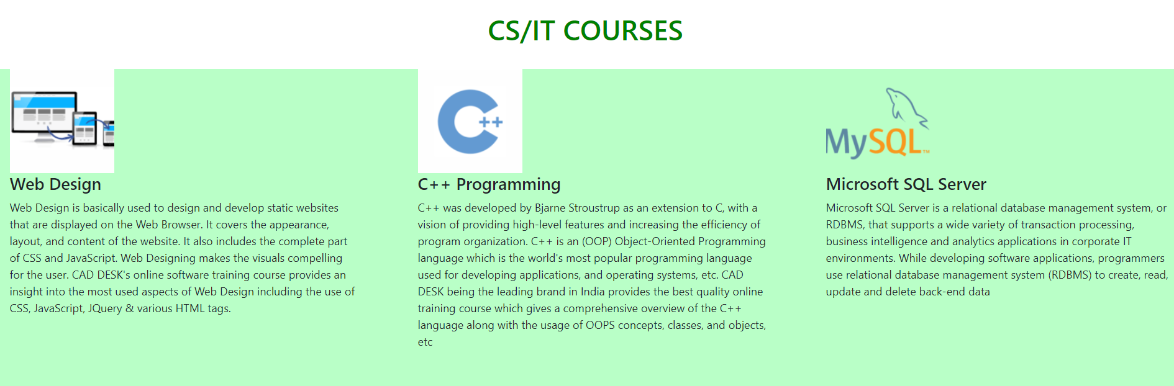
Project title : Course Details

Slide 7
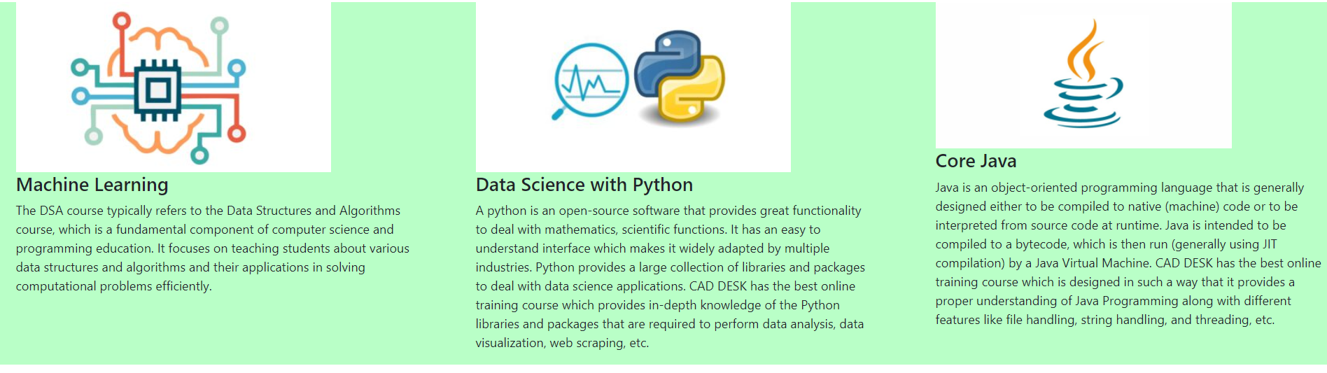
Project title : Course Details

Slide 8

Project title : Course Details

Slide 9

Project title : Course Details

Slide 10

Project title : Course Details

Slide 11

Project title : Course Details

Slide 12
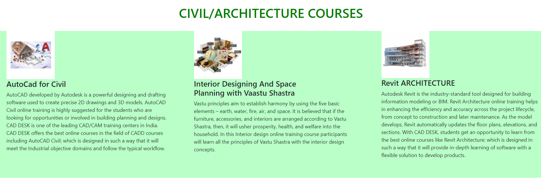
Project title : Course Details

Slide 13
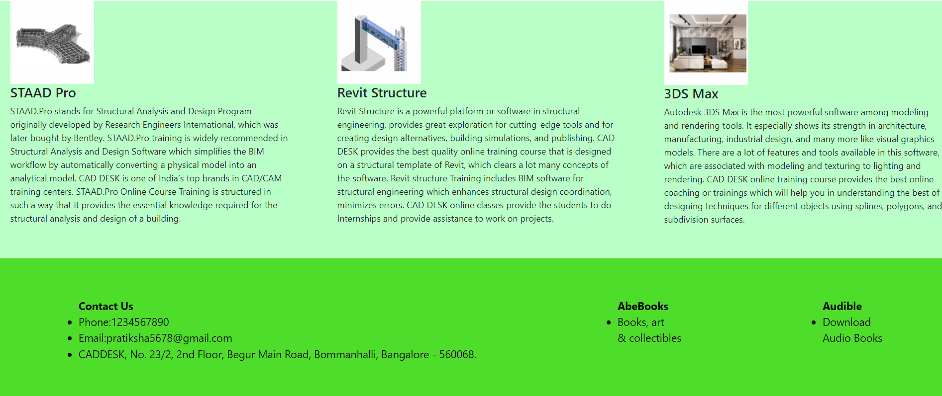
Project title : Course Details

Slide 14
Project title : Course Details
CONCLUSION :
# Our requirement to create a portal for students to select the courses & get the
knowledge on particular course and get the enquiry details from the
registration form.

Slide 15
Project title : Course Details
REFERENCE :
# https://getbootstrap.com/docs/5.0/components/carousel/

Slide 16
Project title : Course Details
THANK YOU
NAME : PRATIKSHA BODKHE
COURSE : FULL STACK PYTHON

